Slide 1
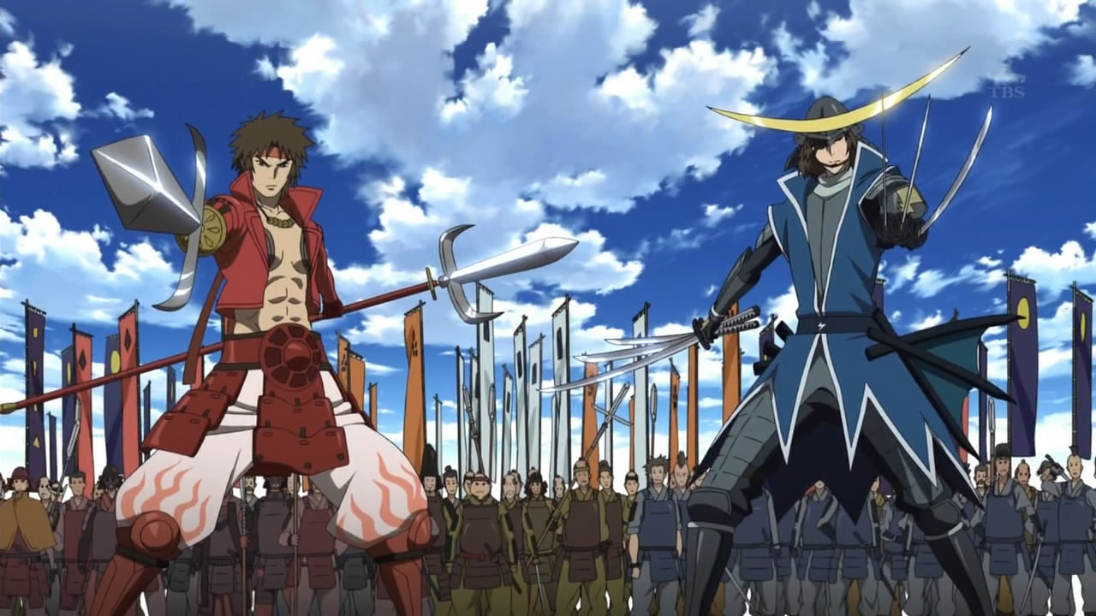
EPIC RESUME GO!
These guys probably have awesome resumes.
Welcome to the Adventure of condensing your career into bullet points

Slide 2
OK, So What Is This About
You hate making resumes.
You have to make resumes.
You want making resumes to be less boring and more engaging.
You can make your resume a creative exercise by calling on your imagination.

Slide 3
Making A Resume Is Telling A Story
A resume tells the story of you.
A resume should tell such a compelling story that someone ends it with “you’re hired.”
When you make a resume a storytelling exercise, it’s a lot more interesting.
When you make a compelling resume, it’s also more interesting for the poor person reading it.

Slide 4
Who Am I?
Steve Savage, Project Manager, Speaker, and Elder Geek.
I write and speak on “Geeky” jobs, careers, creativity, and culture.
I can be reached at http://www.stevensavage.com/
I created this presentation after blogging about resumes and writing a book on it as a lot of resumes I’ve had to read are TERRIBLE.
The job market also sucks so bad I could clean a rug with it and I want to help.

Slide 5
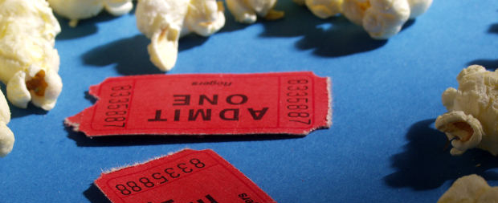
How A Resume Tells Your Story
Being like J.R.R. Tolkein, but less wordy.
It’s like an Epic Blockbuster, only you’re not played by Tom Hiddleston. Sorry.

Slide 6
Like A Book Or Movie, Your Resume Is More than The Sum of Its Parts
Every piece comes together to help tell your story.
Every piece works with the other pieces to tell your tale.
Every piece has to get people’s attention as they have different interests.

Slide 7
The Parts Of An Epic Resume
The Opening Statement – Your “tagline” your “summary.” Gets attention and is snappy.
Skills –“Character Profile.” Shows people what you can do.
Job History – “Backstory.” Tells how you got here and who you are.
Education, Training, and Certification – More “Backstory” and shows growth and focus.
Details –“Extras.” Hobbies, Memberships, etc. provide more backstory and more detail about you.

Slide 8

The Opening Statement
Say what you will, “Dark Lord” is a concise career vision.
Your own personal “A Long Time Ago In A Galaxy Far Far Away.” With less overt merchandising.

Slide 9
What Does Your Opening Statement Do?
This is like a book blurb, movie tagline, or quick summary.
It goes at the start of your resume and sums you up clearly – in one sentence (OK, maybe 3).
It should be memorable.
It should “brand” you – really stand out and be memorable.
EXAMPLE: “A Love Triangle With Two People” – from “Lois and Clark”

Slide 10
How Do You Make One?
First, describe yourself as best you can in three paragraphs.
Then, shrink your description to one paragraph. This is also great for an “elevator pitch”
Then, turn it into a sentence. This is what you use
You can also try and condense it into a quick nickname or summary like “Geek 2.0” or “The Sultan of Swat” or “The Accountant for the Future”.
MAKE IT EPIC: This is where you learn – and sum up – your story.

Slide 11

The Skills Section
This probably isn’t on your resume, but it can still be exciting.
Like all those old character sheets in Role-Playing games, but with more experience in clerical work and documentation.

Slide 12
The Skills Section
This is like any scene in a movie or book where you learn what people can do.
It communicates what you’re capable of.
Makes it clear that you know enough that you’re not Bsing them.
Gives details on what you do so people can get to the specifics – if they care.

Slide 13
How Do You Make One?
List all your skills. Yeah. All of them.
Figure which ones are relevant on your resume.
Put them into groups.
Turn the groups into 4-6 categories and list the categories with the skills.
MAKE IT EPIC: This shows off what you can do, so make sure it shows real knowledge.

Slide 14
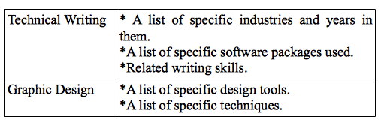
Format For Effect!
Formatting Is Important

Slide 15

Job History
Your Job History Is Your own Epic.
Your Job History as Backstory, but probably with less wavy-lens flashbacks.

Slide 16
Job History
Job History is your Backstory – and in many ways, the core of your tale.
It shows what you have done.
It shows what you have learned.
It shows what you have achieved.
It shows what you have become.

Slide 17
Making Your Job History
List who you worked for, when, what you did – and most importantly your achievements.
Achievements truly show what you did and can do – and help if you can put numbers around them. They are “key elements” of your story.
Keep your achievements to around 3 or so per job, depending, and be concise.
MAKE IT EPIC: Be sure to include achievements that show your career path and skill use.

Slide 18

Education, Training, Certification
Just think, all those years of training condensed to three lines of text!
You have to show off how you spent everyone’s money.

Slide 19
Education, Training, and Certification
Each of these shows off part of your “Backstory,” tells about your growth, and shows your commitment.
EDUCATION: Shows what you learned and can do – or how you changed your mind about that music major.
TRAINING: Shows how you grew deliberately.
CERTIFICATION: Shows professional awareness and the ability to be tested and validated.

Slide 20
Showing Off your “ETC”
I usually go in this very order.
EDUCATION: Show where, what you did, and any extras. GPA optional.
TRAINING: Show relevant training – and where you got it. A few bullet points usually does it.
CERTIFICATION: Shows that you’re committed and validated to your work. List what it is and any involved institutions.
MAKE IT EPIC: Make sure it reflects your skills and story - and this may give you ideas to improve.

Slide 21
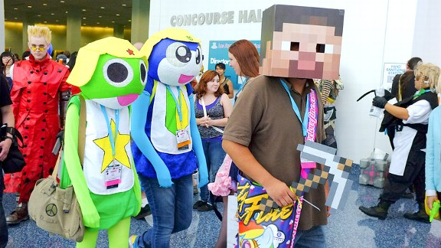
Memberships, Publications, And More
Everyone is a character, just some of us more than others.
The Details Make The Difference – and you probably look less boring.

Slide 22
Memberships, Hobbies, And More
A resume without personal details is boring, forgettable, and dehumanized. Show more about yourself
MEMBERSHIPS: Show what you care about and get involved in.
PUBLICATIONS: Show what you’ve done.
HOBBIES: Show who you are and what you do.
Depending on your career and interests these may or may not be relevant – and that can change.

Slide 23
What Do You List?
Memberships are best put right after education/before hobbies, especially if the memberships are relevant to your career. If you belong to a professional organization, play that up.
Publications and similar achievements should be at or near the end, depending on relevance.
Hobbies should almost always be at the end of a resume.
MAKE IT EPIC: Be sure to include what’s relevant to your story!

Slide 24

Taking It All The Way
Making a Good Resume Feels Like This. But without the hair.
Like any good film, you want to tie it all together.

Slide 25
Be Sure To Go Beyond The Resume
A good resume is just part of the creative exercise.
You can do more – with tie-ins, extras, and further creative activities.
These can get obnoxious, so be careful – but don’t be afraid to dream.

Slide 26
Your “Extras”
Try your resume in different styles, formats, etc. Make it truly creative and yours (Unless you’re boring, like me).
Have interesting business cards – and always have your own business card.
Look for “tie ins” like merchandise and movies. Can you provide code examples, art, portfolios, etc.
Have a personal website of some kind, even if its just a domain directing to your LinkedIn Page

Slide 27
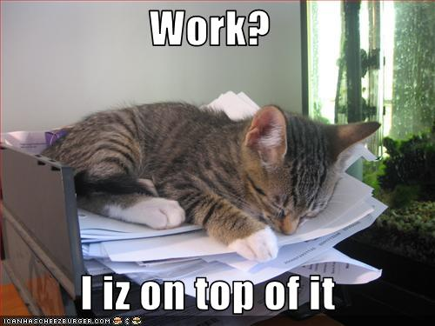
In Closing
Everyone, take a break.
And now, like a good film, this presentation ends. And like a good film, hopefully without lame sequels.

Slide 28
Your Takeaways
Creating a good resume is a storytelling activity.
Treating it like storytelling makes it more interesting to do – and makes a better resume.
The parts of your resume come together to tell a tale, much like parts of a book or movie do.
The resume is just one cornerstone of a larger job search.

Slide 29
Feel Free To Contact Me
Reach me at http://www.stevensavage.com/
Feel free to email me with questions – or answers.
And let me blatantly promote the book based off of this! You can get it at http://www.informotron.com/! There, I’m done!

