Slide 1



?
Team Dynamics and Conflict Management
Jerry Wang, PMP, MBA, MSCS
July 3, 2012
Notes:
Poll-1: Have you heard of Lao Tze, the author of the Tao Te Ching?
Please select one:
1. Yes 2. No
Poll-2: My car was rear-ended and the bumper popped off. What do you think I did?
Please select one:
Wait for the police
2. Exchanged insurance information
3. Took cash from other driver
4. Got excited and yelled at other driver
5. Drove away without doing anything
Organizers and Panelists don’t vote
Original Topic: Fast Tracking to Teamwork by De-escalating Conflict
Logistics – Branding and email and timing…while they are waiting, they will see the ad page…? Can participant hear us before we begin broadcasting? Webinar – clear my desktop. Make me the organizer is an option. But the key is for the participants and the presenters to see as much info as possible. Figure out where to get feedback and get the polls launched – do more polls and etc. – think about. For example: Poll 1 – how many people know about the “Tao”. – think about here to put in the polls. Putting the material on the web site afterwards. Do it as a slide – share the source. – send a version – denote where the poll is at the top of speaker’s notes box in bold. Citrix. – get a list of attendees after the webinar. Presenter to get the questions from the moderator. I am to set up the question segment in an expanded manner. – how to answer all the questions for 10 minutes… start at 6, intro for 5 minutes.. More time for people to show-up.. Then you give me 5 minute warning.. H ow to deal with the control panel.. Get all of the last minute guys who log on.. control panel.. The Q & A
-remember to start the video recording
- Survey has been set up…
Raise-hand (explain where to raise the hand – hand is raised so if you see a red icon with hand down, that means the hand is up), submit questions, introduce, recording.
Hello everyone! Kindly take a minute to review the controls on your Citrix client to make this session as interactive as possible. Raise-hand tool and there will be a few polls to get your input during the workshop. Kindly maximize the window that views my desktop.
For Webinars, the window size should be just large enough with room on the right to show the Webinar Control panel
Webcam is on at this time!
Jerry to introduce the session. So people know how to absorb or digest the material. This session introduces some observations about human nature and to the extent you agree with these observations, you are invited to use them as reminders to yourself as to what to do or not to do during conflicts. These human traits also help us to predict how other’s would behave in a conflict as well as why people are behaving a certain way. This understanding would give you the insights necessary to defuse and prevent conflicts.
Approach-for-opening: Keeping perspective on the topic: Set the topic up more for Bob at the get-go. This session will give you x-ray vision. How this presentation will give you what. How are you going to use it. Set the stage at the beginning on how this material can be used. Two pieces. Lots theories. Keep relating it to topic at hand. Program manager. Manage team dynamics on the job and project and correlate material to that. Tell them up front on how to consume the material on how to best apply it. As we go thru out. Keep relating it to conflict management and team dynamics. When you examine yourself as a project manager and not as an individual. When you are a project managers, these principles will come up so these principles will adjust. Role of a project manager, need to recognize these situation.
- When I get the five minute sign before the session ends, then finish off the current slide and then jump to the conclusion. Use the word for session, event, and not “workshop” in webinars.
Poll questions:
Please guess what my response to the accident was:
Wait for the police to write a report
Take cash for the damage
Forget it and drive away
Scream and yell to release the stress
This webinar is recorded as requested by your organizers Person-A And Person-B. So the record button is being pushed right now.
How many are familiar with the Tao Te Ching which was written by Lao Tze? Kindly click on the control panel to raise your hand.
So Can we have a show of hands of the people who have heard of the Tao by Lao Tze? (look into the attendees sub-panel
Turn on the light for the webcam and make sure webcam is available.

Slide 2
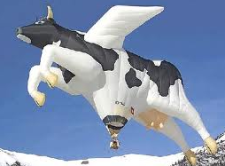

Practice Identifying the Principles
Someone, anyone:
What is the creative principle of flight?
Does this creative principle of flight transcend size, shape, space, and time?
Another one:
What is the creative principle of the Agile Methodology?
Does this principle transcend company/project size, industry, and cultures?
Notes:
Chat-1: Ask people to type in what is the creative principle of flight.
Chat-2: Ask people to type in the creative principle of the Agile Methodology.
Soup and salads are served before the entry and then the dessert. Showing quick results for the customers to enjoy, appreciate and to enjoy solutions that reduce their problems and increase their income.
For webinars, please type in your answer to the creative principle of flight and of the Agile methodology in the chat box as to what you think is the creative principle of flight.

Slide 3
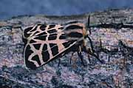
Why, What, How of Principles?
What is a principle?
Predictable
Repeatable
Works anywhere, any time, with anyone
Works with or without your understanding or agreement
Why Principles?
What are constants in the world?
Changes (e.g., size of bat’s prey)
Principles (e.g., bat’s radar & Tiger moth’s radar jamming device)
Principles transcend space, time, and circumstances (i.e., timeless).
COMPANIONSHIP - Reliable & always there.
Acceptable(i.e., convincing) & Workable (i.e., effective)
Notes:
Chat-1: Ask people to type in their definition of a principle.
Chat-2: Ask people what are the two constants in life?
Any questions before we leave this slide? This is the basic definition so the process would be for each person to examine if something is a principle thru observation and testing. Once you believe something is a principle, then the principle can help you to you to understand the situation, navigate effectively, and create the results you want.

Slide 4
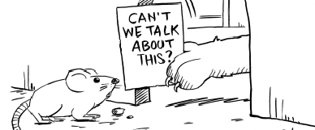
Share The Principle of Negotiation
Notes:
The young man buying an umbrella. – the principle of negotiation…
The principle of non-contradiction.
The village elder sitting court. Abdul complains and says that Hussein drives his flock of sheep across his field to drink from the river everyday trampling his plants and that Hussein should not do it again. The village elder answered “You are right”
Hussein then spoke up in his own defense by saying that “it is the tradition that any shepard is givent he right of passage to go over any person’s property to get to the river. And the village elder answered “ you are right”.
Definition of conflict: Principle of Collision: Objects moving in different directions or at different speeds – so you have collisions.
One source of conflict at the work place – industrial revolution, specialization, differentiation with deep and profound knowledge in each functional area – This gave rise to the need for a coordinator, planner, or manager to control flow, pacing, and handoff criteria. Interdepartmental or organizational siloing is one source of conflict in the work place. But that is only a very small part of the conflicts we experience in the Workplace Ecosystems.

Slide 5

What this Session Covers
Why Synergistic Teamwork is elusive?
The foundations for human conflicts. Strike at the root…
How to De-escalate Conflicts?
Understanding the Anatomy of Conflicts
The Anger Development Life Cycle
The Anger Project
How to Cultivate the Conflict De-escalating Muscles?

Slide 6
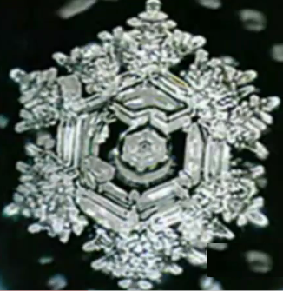
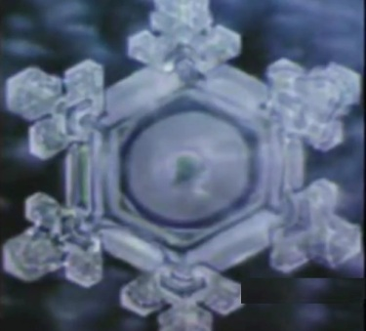
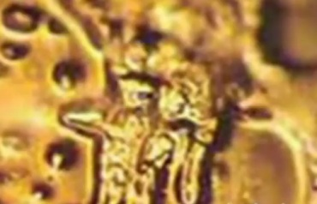
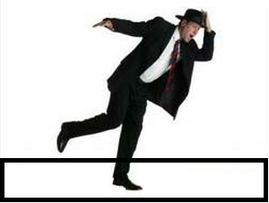
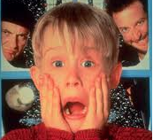
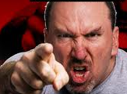
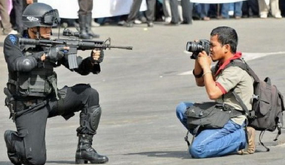
Foundation: Thoughts and Actions Create Us
The power of each thought:
Ice Crystal being symmetrical versus gnarly (video)
Walk a Plank on the Ground versus Elevated
Behavioral Kinesiology
Tell your real name and a false names
Think of someone you love and then someone you dislike
Notes:
POLL: What emotions do you feel when you see the picture of the man with a camera taking a picture of the barrel of the assualt rilfe? (do this poll after the last picture is shown…)
Fear
Apathy
Disbelief
Anger
Surprise
- Explain the video before and explain the process of exposing the water.
Visualize that there is a plank about shoulder-width apart in your room and that you need to get up and walk across it. It is fair to say that most people could walk on that plank. Yes?
Now let’s put the same piece of wood between two 50 story buildings on a windless day, and you need to walk across the plank. Can you walk across the plank? If you don’t think that you can walk across the plank, what would you be thinking? That thought is knocking you off balance.
Show video on webinars in a small screen due to latency - Click on walk to see Alex Honnold climb.
Behavioral kinesiology has statistically proven that our bodies are instruments of truths. The body is strengthened is we tell the truth and the body is weakened when we tell a lie. For example think of someone you admire and that should make you feel better and stronger. Now think of a puppy being run over bya car, that thought typically drains all the energy from your body. What’s the point? The point is that each thought can strengthen you or weaken you so choose and limit your thoughts very carefully. The collective unconscious flows thru the human mind as you can observe in your own head about the 12,000 to 60,000 thoughts that go thru your mind daily. You don’t think many of your thoughts because if you did think all your thoughts, then you can stop thinking but you can’t stop thinking. We can focus and limit the mind from wondering all over the place. It’s like no one is at home. The universal starting point of controlling conflict begins by the mind understanding and applying specific principles.
Fear makes your face go pale and you cower. Anger makes you rise up and your face turns red.
What emotions do you feel when you see the picture of the man with a camera taking a picture of the barrel of the assualt rilfe?
Whatever emotions or thoughts you have on the camera-vs-rifle picture is purely your own making based on your predisposition and personal filters. All afflictive emotions or all emotions are internal by nature. We can condition our responses or we would react per our scripting or programming. Either way, my interpretations, rections, emotions, and feelings are entirely my.

Slide 7
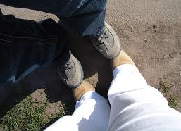
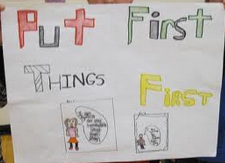
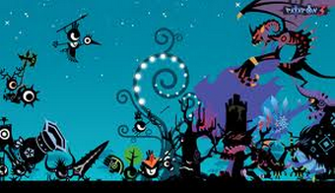
Counterfeit Principles- Buyers Beware
Caveat Emptor!
Determined => Stubborn
Passionate => Blind
Action-Oriented => Careless/Reckless
Helpful => Not Results Oriented
Result Oriented => Insensitive
Life IS “fluctuating systems of conflicting principles” with varying priorities that
change moment-by-moment!
Notes:
-
The picture in the lower right hand corner shows that the situation is constantly changing. Many factors are coming into play while many things are vanishing or no longer in play…
- It is easy to get tunnel-vision and dogmatic about applying principles.
FTF – does not mean anything is first.. So principles are easy to misunderstand and even easier to mis-apply.
- any questions?

Slide 8

The Elusive Synergistic-Teamwork
Walter Wriston, Citigroup CEO Emeritus:
The Person Who Figures Out How to tap into the Collective Genius of everyone in the organization will blow away the competition.
Why improving personal skills is often so slow?
The four stages of Learning
Unconscious Incompetence…
Creator’s complex
Need for Significance: focusing on external approval would likely slow personal growth
Know a lot and do a little. Nothing works until you do
Notes:
Improving personal skills are slow because:
4 – stages of learning… Need to memorize a few principles once you have validated that the principle is a real principle.
I am right. You and everyone else are wrong
I am stuck and I can hear you but I can’t move my head or body. I am pinned down by my emotional trauma and I am not up to dealing with things.
The point of sharing this is to invite you to fully rally your resources to take yourself to the next level so we can be sure no one moved my cheese.
- Satified needs do not movitivate. Poverty gives rigor. Too much sugar in the blood give diabetes. Too much protein in the blood gives gout. Too much sleep makes groggy. Too much food stops me from breathing. Too much sun burns and too much water drowns. The lack of something and the pang of hunger makes food particularly tastier.

Slide 9
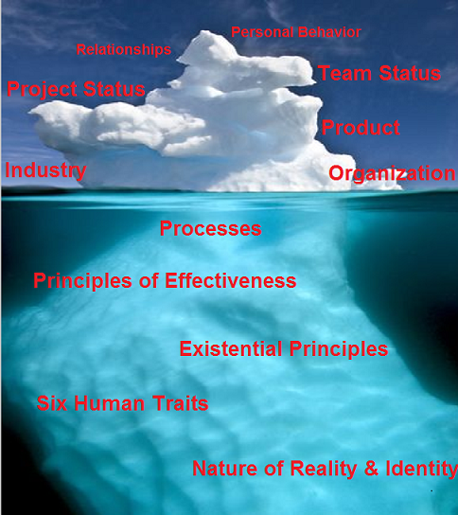
The Ecosystem of Conflicts
Notes:
Give examples of conflicts
With the Global Logistics Manager.
Solutions Architect/Network Architect – spoke to her human need to be significant and the fact that the team is new so basic trust has not been established yet…
Processes can create conflicts. Project coordination group creates service requests and the Systems group deletes the service records while they sit with 15 second walk of each other. WHY: the organizational culture is imperialistic and the senior managers are more focused on expanding territory and in dominating the other managers.
CEO calls for process improvement meetings and the director does not show up and they had this other senior manager had done a process mapping about 18 months ago and it was a complete wash-out… Cross functional process improvement depends on cross functional cooperation and trust. So it depends on the Principles of Effectiveness. Why do 80% of process improvement initiatives fail? Lack of leadership. Why is leadership critical? Who built the great wall of china? The emperor. Likewise, who built the interstate highway or the city sewer system?
Why do you think the focus is on the “Six Human Traits” for Conflict Management? We could have focused on the team or organizational perspectives. The point is, often times, we have no direct control over cultural, process, or team structures but there is one thing we have some control over. We have some control over ourselves and if we understand our own nature, and can identify principles which allow us to work with others, then we can find leverage for understanding and de-escalating the conflicts. No matter how severe the conflict, you can use the Six Human Traits to transform the situation as many have done. If you know how to define yourself to face off with different conflicts and know how to leverage other people’s human traits, you can navigate accordingly like how the captain can control a ship or plane from the cockpit. Everything flows from the CPU and the Six Human Traits are the controls in the cockpit. All the differences and difficulties do not have to turn into conflicts. They become conflicts because of the Six Human traits which interprets a situation dualistically. This duality instead of unity creates the conflicts.It’s like you are standing in the ocean and when the wave comes, you jump up to float with the wave and keep your head above water. It is not useful to be attached to the bottom and be tumbled by the waves. The moon and the tide are greater than we are so it is easier to work with ourselves in the confines of organizations and projects. Self-definition is important because the brick and rocks have less uses than the grains of sand in construction.
We live in an interdependent reality where everything depends on everything else. Water flows on a slope because of gravity, thunder claps because air rushes in to where the lightening has burned up all the oxygen creating a vacuum, earth collapses because of sink holes. Nothing is independent in this world and neither is conflict. The very existence of conflict relies on existence of more than one thing. Even when a person is unhappy with oneself, it is because of where things are is different from where the person would like things to be. A car cannot bump into itself. So one way to eliminate collision is to become “one-with”. The study of the Tao allows one to become “one with others or one with the situation”. To find a way to merge psychologically with a situation, a thought, a company, or a family; is key to remaining in ease and more likely for you to be like that thin slice of sweet and cold watermelon on a hot summer afternoon. The easiest way to be one-with-something else is to observe what is happening without holding on to a fixed opinion at that moment. Be observant, mindful, and aware, without judgment is the first step to minimizing conflict. Wait for an answer to emerge in you rather than passing lightening quick judgments which are basically internal or external collisions. When you are physically close to someone else, it makes kicking and punching more difficult though one can still bite, scratch or do head-butts. So when you are closely observing something without judgments, there are things which will still get under your skin. So, here is a bird's eye view of conflicts.
To understand the ecosystem allows one to navigate around conflicts. Let’s look at an example of personal behavior on the Life Glacier: On one project, we were ready to ship about half a million dollars' worth of equipment to China for a Network Operations Center. I walked into the office of the logistics manager and after glancing up for like a second, the manager said that he is busy and can’t talk to me. We are on relationships now I kept on walking towards his desk and he added “I said I have no time to talk to you and you keep on walking towards my table”. I kept on walking and when I reached his table “I said that I object to this. I have left you two phone messages and sent 4 emails over the past 4 days and all of which were unanswered by the logistics manager. I said that I am perfectly happy to observe the boundary he set if he could tell me if he was still responsible to ship the devices to Beijing. If he was no longer responsible for logistics, then who is. At this point, his face turned beet-red and he had become tongue-tied in front of the other 3 logistics staff. From the team’s perspective, this was the first team we had worked together so everyone was still going thru the storming and norming stage of the team development stages which includes: forming, storming, norming, performing, adjourning. The newness of the team partially explains the disconnect. From a project perspective, the project was in the controlling and monitoring phase of the five project phases which are: Initiation, planning, execution, monitoring/controlling, closing. As we get closer to closing, there is more pressure and tension which enable conflicts to flare up. This was a new product in a maturing industry. About 50% of the world’s 35 mm movie projectors have been converted to digital projectors and the market leaders are moving to seize the market share. That was the first time the global logistics team ever had to ship IT devices overseas so it was extremely time-consuming and error-prone. One major cause of conflict was Organizational because the Global Logistics director wanted the divisional logistics manager to handle the shipment instead of the global logistics manager whose team was inundated with work. The company had grown very rapidly and the teams are doing many things for the very first tie so there is no set process nor clear roles/responsibilities. It is on the cusp of going from national to multinational like when McDonalds left the US and went overseas. Know that many weaknesses can be overcome by some areas of strengths. There are people who are extremely helpful and they can get people to do things for them because they are effective. Some people are very persuasive while others very efficient. When people resort to conflict, it is usually because they are not skilled in applying the principles of effectiveness. Maintain boundaries, emotional stability, and to have emotional resilience are key life skills or existential skills. As I understood the situation a little better, I jokingly said to the global logistics manager that when we have a problem, we solve the problem rather than creating another problem. Rather than trying to stonewall me, we could have done many other things. In our interactions, the 6 human traits were pervasive where we could only see the situation from our perspectives we each thought we were right in doing what we did. The Six Human Traits are the focus of our time together today. Of course, we then live in human reality which has its own characteristics which is covered in a different workshop.

Slide 10
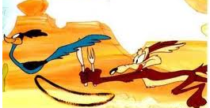
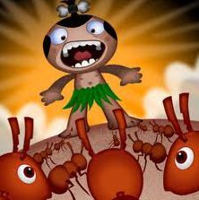
The foundations For Human Conflicts - The Six Human Traits
Personal filters – Holographic, dualistic view points. We can’t help it but to make “assumptions”.
Distinguish and catalogue new filters
Judgments limit personal freedom
Creator’s Complex – We naturally feel our personal filters are the correct ones which leads to imperialistic righteousness and when violated, leads to indignation.
Making the handle of an axe with an axe
Know your own nature
Being Certain <> Being Right
Notes:
The word “foundation” links to the Life Glacier. Use the shipping devices example that once the project had 2 days left before making an international shipment and the logistics manager did not – don’t click on it.
“Human” links to the map of consciousness… - don’t click on it.
“assumptions” are basically our view of reality or our perception of the situation.
Personal filters - (when I was a kid, I would run over to the cornerstone grocery store) I grew up getting eggs and other groceries from the neighborhood grocery store on credit so the context from which I view the world can be very differently from my coworkers. What is meaningful to me might be completely meaningless to others. I got into a fender bender last month for the first time in 35 years. The lady who rear-ended me on freeway 10 drove an old Toyota and I did not ask for her insurance papers. Neither my family nor friends understood why I did not take her insurance papers, perhaps it is because I drove without car insurance for over 10 years. The point is, we each live in a very unique and personal world. Poll-1!
Antidote: We can’t be objective but we can compensate for our subjectivity. One tool that supersedes our personal filters is the Talking Stick. Has anyone heard of this? Raise your hand, please, if you have heard of it. How does it work? There is a different version of the tool where you can unilaterally and independently use which is that you will not take the floor until you get confirmation from the other person that they think you fully understand them. Then you seek to be understood which is habit 5 of the 7 habits of highly effective people. This way, we can lessen the severity of the human trait that we could only see, hear, and process the world thru our personal filters.
The human trait of Creator’s Complex is hideous. Whatever the person feels, they believe they are right even when they believe they are wrong, worthless, or guilty, they believe they are right. They can becomes depressed about who they are. This is what leads to righteous indignation. Share Jojo’s polar bear story… This senior manager fancies himself to be a mafia gangster and since our customers were in New York, he would say things like this in the all hands meetings: “You know the customers in New York are not really listening and after the new year, we will take off our gloves”. I often listen to others in amazement and ask in my head “are you for real?”. I am looking at this with my personal filters of growing up where people get cut up with samurai knives. Because of my personal filters, the kind of tough-talk conversation seems a bit childish…
Creator’s complex probably is the most destructive human trait in that dictates how human beings exist as beings. Being right, important, and accepted worth a lot to any human beings and many people strive for it at all cost. Why is that? That is tied to a key human need. The basic human needs are the needs for significance, contribution, growth/learning, support/rapport/friendship, change, stability. Creator complex ties into the need to be significant and the need to contribute. Since different people have different needs at different times, then by finding synergistic tasks, the person’s need to be significant can be satisfied on non-conflictive ways.
The antidote to Creator’s Complex is to know that “being certain is not same as being right”. Instead of huffing and puffing in defending oneself and attacking others, it’s best to calm down. No matter what I say, I felt slighted when I was passed over in making a presentation and I confronted the leader. In retrospect, I did say I was not going to be available for a few months. Not to make excuses, it is when our buttons get pushed, we feel most righteous and in fact that is the moment when I am most reactive. I want to be prompt in my interactions and hold others accountable and at the same time, I don’t want to be a reactive dinosaur. I was preparing for my short presentation while waiting for others to finish and then I was skipped over which surprised me and my Creator's Complex and predisposition took over. I control myself better and am more aware now. This is hard because once the octopus has inked, the water is murky and o one could see. My mind becomes clouded and becomes creator’s complex which can see everyone else but itself. There is lot we can learn from nature or the Tao. For example, the silence of the woods and the wonder of a thin slice of cold watermelon on a hot summer day. There is the Tao of becoming a thin slice of cold watermelon on a summer day which we could examine on some other day. Let the initial reaction pass and then examine the evidence if you need to. Invariably, when you have an upset, it is because you have rested your identity on someone or something rather than being unhinged from expectations and physical reality.

Slide 11
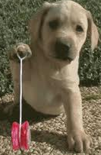
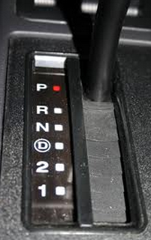

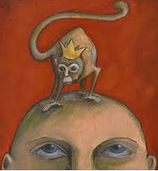

The foundations For Human Conflicts - The Six Human Traits
Shifting Identity – Letting someone or something shift you into a victim state. Lean on them?
If you are truly humble, you would not be…
One-pointed-focus unsticks the mind and identity (e.g., Optimism, Gratitude as a default state)
Tit-for-Tat – The need to get even and retaliate.
Keeping score limits your freedom to be your best.
Chattering Mind – 12,000 to 60,000 thoughts go through our minds daily which can reinforce any negativity of the fabricated personal filters.
The flag moved…
Yon don’t think all your thoughts.
Notes:
The human identity is like our physical balance. The body needs to balance on the feet, or to sit on a chair, or to lean against a wall. Similarly, the human identity is constantly shifting and goes out of balance just as readily. We can shift from being fearful to being courageous. What happens when the fear is gone? When the fear is gone, courage also vanishes. That’s why some people say being neutral is a more powerful state than being courageous. Let’s look into the Tao of nature. Look at how the leaves and the roots grow. There is neither fear nor hope. The leaves and roots of plants are obstacle-agnostic. When a leave or root hits an obstacles, they don’t get angry and hit the bottles, they just keep on EXTENDING forward in the direction of either Sun or water which give life. We can think of the leaves and the roots to be single-mindedly focused on seeking life.
The antidote to being shifted per John Wooden is to “do your best” which is how coach John Wooden defines Success thru Peace of mind. If you focus on doing your best rather than focused on how you are doing relative to others, you stay in unity rather than duality. Another technique to not escalate a fight is to observe and notice what is going on without passing judgments/awareness. And Yet another way is to focus on relaxing. The point is no matter how fast the mind is, it can only focus on one thing at a time. So if you actively focus on relaxing, your mind is tied up in focuse on being relaxed and if the mind if tied up, it has no time to monkey around by creating habitual thoughts or random thoughts which then trigger habitual emotions or random emotions. When you are in a conflict, you can focus on relaxing to avoid being shifted. At the same time avoid saying or doing things to shift others into over-drive or reverse. Words have the power to create or to destroy. Even more powerful is silence. People love nature and go hiking in the woods because the tress are not constantly talking and offering up opinions. Silence or just to listen to someone’s story is one of the most powerful tool. To be mindful of the shifting identity principle during a conflicted situation allows you to remain neutral and if you have the skills to validate others thru Talking Stick Listening, you can actually restore peace in the other person and shift them back into neutral or closer to it where a semblance of peace begins to return.
- If you are truly humble, you would not be proud if people were to praise you and you would not be discouraged, if people were to criticize you.
Antidote to being tit-for-tat is to assume others are doing their best and they have/had the best intentions. Have the pride of knowing that you are self-mastered, self-determined, and self-reliant. Sometimes people we like the least have the most power over us. Why? Because we want to control them. Let’s look at the anatomy of trying to control other people. It is actually a fallacy. The more we try to control other people’s behavior, the more these people control us. Every time they don’t behave the way I think they should, we get upset which really means that they are controlling us with their behavior. The antidote is to look for unity such as a personal vision, self-selected intention, or personal mission that is to assume everyone has their best intention or to acquire certain expertise at home or at work. We can say no to tit-for-tat which is really letting the other person dictate how we should behave. We are being infected by the other person’s energy and intentions as we interpret their behavior through speculation. Human nature has a knee-jerk response to perceived insults and injuries in self-preservation motivated fight-or-flight. How about we take control of our thoughts and emotional state and not let other us play us like yo-yos. How about a little de-programming and re-programming. Since it is a principle that any thought that you repeatedly think becomes a belief, and over time a lot of the repeated thoughts have been forgotten by the conscious mind and the subconscious mind has this belief ingrained as an automatic response. I believed people were out to manipulate me and control me so I projected that and had automatic reactions towards others whenever my “Don’t Slight Me” radar detected perceived slights. It was a self-fulfilling prophecy where someone with no intention of slighting me ended up being offended by my accusations and then felt slight towards me. Talk about creating slight when there is none. There on the other hand, even if someone slights you explicitly and overtly, you can still rise above it by assuming that is the best they can do and they mean well. The key is not to reason thru other people’s behavior because interpreting human behavior and decipher human intention are untenable tasks as well as ungraspable. It is a complete waste of time to read the tea leaves. It is best to focus on our personal goals and agenda rather than trying to figure why someone did something. The above sentence is a thought and if this thought is repeated long enough, it becomes a belief. Once something is a belief, then a person becomes predisposed and has a conditioned response to that situation. This is an active tool that we can use to deprogram and reprogram ourselves to when people are distressed, they will actually experience us as a thin slice of cool watermelon in a hot summer afternoon! It takes more than not retaliating to become a thin slice of cold sweet watermelon on a hot summer day but it is a key characteristic of being a soothing, calming, and comforting presence. The need to retaliate basically says you are not being your best and that you surrender any ideal you have because of someone that you are not liking very much at the moment. By keeping score, you shrink your own happiness by experiencing the anger from others and the anger you feel inside.
With the logistics manager, my assumption was that his existential skills or life skills of setting and defending boundaries needs to be improved because his actions were not effective in resolving the inter-organizational issues. He tried to force me to go work with the senior logistics manager in another division but it was not very well executed. I decided to act as if nothing ever happened and sure enough he continued to go out of his way to be helpful to me. It is also a principle to assume the best because that assumption is the most empowering to me personally with minimal loss of power.
Antidote for the chattering mind: Your mind is the best story teller in the tower of Bable. The chattering mind combines crazy thoughts with crazy emotions. It’s like me looking at someone else’s food and salivate which is clearly inappropriate because the food is not mine. To de-escalate conflict, the best thing to do is to be extremely aware and focus the mind to observe rather than to get carried away with the random reactive emotional thoughts like the leaves being swept away in the autumn gale. Going back to the quality of a slice of sweet watermelon on a hot day, the coolness of the watermelon is generated from within without taking on the heat of the sun or the harshness of the ground. To stay spacious and magnanimous, the mind needs to be spacious and non-aggressive with minimal turbulence. People say when you put fire to paper, the paper burns. If you pour water on fire, the fire goes out. If you put water in the pot, you can use fire to vaporize the water and if the fire is hot enough, it can melt the pot. So give space to the fire and the fire will burn itself out. To train the mind to be spacious like giving cows a huge pasture to roam around

Slide 12
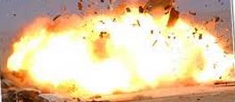
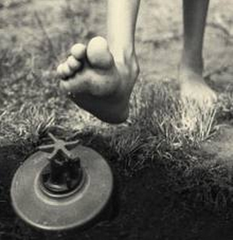
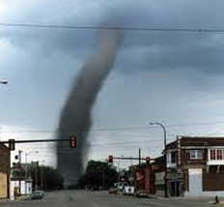
The foundations For Human Conflicts - The six human traits
Predisposition – Prior conditioning.
The goal is to be free from predispositions and be able to choose a response under any circumstances (note, this is an impossible goal).
The high-payback and dangerous art of Mirror- Reflecting for critical stakeholders. Controlled Explosion
Notes:
- My reactions, the reaction of the global logistics manager, the reaction of the solutions architect, or the reaction of the senior manager who refused to participate in the process improvement efforts.. Are all conditioned responses… So called pre-disposition which means it is not PERSONAL. I should not take their conditioned responses PERSONALLY (-;
The human trait of Predisposition is what creates unpredictability. Once two CTOs were having some disagreements and I tried to mediate and it blew up where they used what I said to attack one another. I worked on this project and the entire team paid a heavy price with me leading the charge but I felt victimized afterwards and left the team. I invested a lot to see the team thru and I had a bad reaction when I felt the senior manager expected me to continue the grind for their aggrandizement. That was a conditioned response which just swept me away.
Personally, I try to remove as many buttons as possible. Sometimes I am shocked at the intensity of my own reactions when I am provoked. It is very dangerous to have my button pushed especially when I deal with my spouse and daughter. After some of these exchanges, I would spend time to visualize a different response and action than what I actually had. My daughter refused to go to school one day and it srated from 6:30 am until 7:40 am..finally…
By controlling and steering clear of the human foibles, we do not add to the intensity of the conflict. By working with other people’s filters, understanding their blind spots and their Creator’s Complex, as well as their tendency of tit-for-tat, you would navigate in such a way so as to not aggravate the situation. For example, if someone is stuck on their personal filters, you would empathize with that and you could validate and affirm their filters by using the Talking Stick Listening technique. You can hear their sense of certainty and righteousness in their Creator’s Complex and you would acknowledge that by showing that you understand they are entitled to their opinions and not to negate that by saying something like, I see your point. How about this?
- After sizing up this CEO’s incredible good disposition, I took the liberty and said that “I know you have great intentions when you make these promises but when there is no follow-thru, it looks like lying…
One way to defuse a difficult situation is to use the dangerous technique of mirror-reflecting which is less risky to you if you are the boss like when Jack Welche was a new CEO at GE, he visited a subsidiary and Jack Welche told the managers who met him at a party that they were mainly concerned with face time with the CEO. He questioned if they were dedicated to their employees.

Slide 13
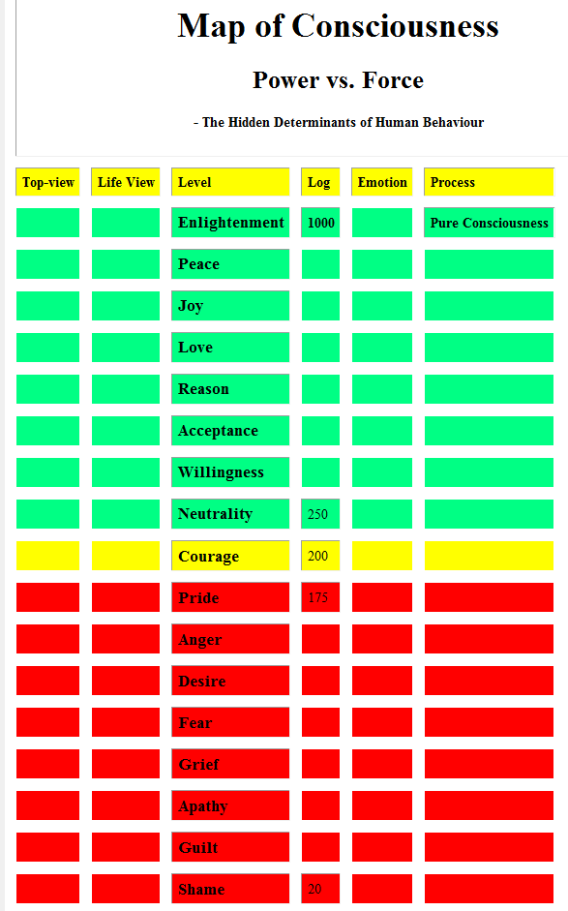
Your Mind Realm = Personal-Fliter + Creator’s-Complex + Chattering-Mind
Notes:
Since all conflicts begin intrapersonal or internally and conflict continues internally or intra-personally. When you ask “why am I fighting?” and decide not to engage in the conflict any longer, then you are no longer conflicted. Calm and inner peace returns to your psyche and being, even though strife continues around you. You can be at peace in a conflicted situation.
Since all conflicts start internally, it is important to be aware of the energy vibration we create in our mind. Emotions come from thoughts so if we control our thoughts then we control our emotions. A major step towards self-determination, self-mastery, and self-control. So whatever filters you use to view the world and being so convinced that you are right, you would repeatedly think those thoughts until you create beliefs and faith in those thoughts where you begin to create your predisposition and program your automatic responses. Being aware of the connection between thoughts and emotions and your predominant energy vibration, you can concisously choose thoughts which empower you and make you feel more at ease and at peace.
Throughout my day my predominant energy goes from fear, to anger, to desire when my mind is in charge. When I am mindful I consciously focus on reason, acceptance and neutrality. Neutrality is when people say “it is what it is”. You can call it good or you can call it bad. It is what it is. Notice that neutrality is higher than courage. Is that true and if so, why is it true?
Courage is an action that is a reaction to fear. Depends on how you express your courage, for each action of courage, an equal and opposite reaction is created. Courage is reactive in that it is to overcome something and when courage is expressed in an immature manner, courage could come off unruly and barbaric. In other word, courage needs to lean on something to exist. Any time, you lean on something, your balance depends on it and you can lost momentum or balance either when the enemy that instigated the fear is gone or when your courageous action has created counterforces that stops you. Neutrality is more self-generated and it does not tip over or run out of steam. For example, a personal mission statement of “advance human consciousness and reduce human suffering” can propel a person to take on the tasks to heal, strengthen, and grow an individual or an organization. Such principle or will exhaust itself only when human consciousness needs no more advancing and that the human suffering has ceased. Both counts are impossible because ach new generation must relearn the truths to personalize the principles.
Are these emotions external or intrinsic? All of these energy level are internally generated and cultivated. An angry person tends to react angrily towards all things. For example, when a person is tired and hungry, they tend to be crabbier.
The emanating source of these energy vibrations come from your core beliefs and core wounds. It is absolutely crucial and essentials to de-program and re-program the core beliefs and at the same time or even before then, you would heal your core wounds because those automatic reactions would be triggered in your daily life and that the core beliefs filters limit you which can cause a lot of stress within your head. All afflictive emotions are internal by nature.
The Map of Consciousness is useful in that angry people tend to respond angrily so be extra cautious. Also, I look at my predominant emotions which arise from my core beliefs. I saw that when I woke up in the morning I felt fear about what I need to do for my projects. Then throughout the day I would feel anger and desire. This is where things like yoga or visualization help. I would learn to focus the chattering mind on one thing and then after the Yoga class, I would continue to be aware of my breathing and remain relaxed. This is where I can get to reason, acceptance, or neutrality. To be aware and to take the high road has been helpful to me. To get to joy, that is a different story, Alice Sommer Hertz, the 108 year old survivor of the concentration camp survivor seems to be joyous and my personal guess is that her calmness and peace probably flow more from her 4 hours of daily piano practice than from her attitude. It’s like you don’t get strong arms by htinking about doing push-ups, you need to actually do push-ups. When the mind is focused for long periods of time on positve energy, then the mind takes on that vibration and unplagued by all the projections, fear,a nd other garbage that flow in and out of your mind.

Slide 14

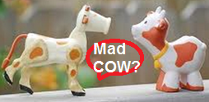
The foundations For Human Conflicts.
What are Personal Filters?
What does it mean to say “Fish Discovers Water last”? (e.g., Cant’ see own facial expression; Also, companies can’t see own functional problems).
Can a person look at the world without using Personal Filters (e.g., What motivates you to volunteer).
What are some filters we use on people who are not as motivated as we are?
Is it easy for you to look through other people’s filters? (e.g., Fame: lacking a slide clicker).
Is it easy for you to admit that your filter was wrong? (e.g., Brother, abandonment?)
Know thyself and limits! Certainty<> Correctness
Notes:
- Now, let’s put the six human traits into application nad put it together to describe how to handle conflicts.
-In a conflict, you can see everyone else thru your personal filters and interpretations. You can see everything except how others are processing you and how your presence and behavior are impacting the situation.
- It is not easy to see that my personal filter, let alone seeing that it is wrong and to admit that my filter was wrong even afterwards is difficult in some cases. IN some cases, I don’t think I was quite right but even after 2 decades, I am having a hard time seeing or admitting that I was wrong. For example, when my brother got in trouble with the law and ended up in and out of prison for about 20 years, I never went to see him I the name of holding himself accountable for choosing to use heroine. In all aspects, I should have gone to see him but I did not and even when I think about it now, I am not sure if I could take me to a different filter….
- As a volunteer at the LA chapter of PMI, I routinely refused to get hardcopy certificates for the volunteers on my team because most of the team members do not attend the dinner meetings. So one year, I asked if anyone was interested in having a paper copy of the volunteer recognition certificate and no one replied so I opted the entire team out. Then this volunteer happened to show up…
- Once I was a volunteer with an organization and the moderator would need to sit there in front of the room advancing the slides for the presenters rather than using a clicker. So I suggested a few times for the moderator to obtain a clicker and finally I brought my own clicker and installed it for the presenters of the evening. The moderator came around and took out the clicker adapter from the USB port and proceeded to advance the slides manually. That’s when I realized that the moderator enjoyed being in front of the room advancing the slide which was the real reason for not having a clicker. Once I saw that, I was glad that he enjoyed that task and wanted to do it.
Last bullet: Here is a joke about knowing yourself: Two cows are standing in the pasture and one says to the other, what do you think about this mad cow disease? The other cow responds, what do I care? I am a helicopter.
- When you are mediating for people who are in conflict, you can point out all the prevailing paradigms to remove as many blind spots as possible. For example, this solutions architect requested the US expert to provide onsite support later rather than sooner because she felt confident that she can bring up the network and the expert just needs to be in Beijing at the very end. That way, everyone could see her prowess and she would get visibility and credit for her efforts and insights. When the customer’s management requested the US expert to provide onsite support sooner rather than later, she was resistant and kept on insisting that it was a bad decision for the US expert to go so early. She said it would be a waste of time because she had handled everything already. After explaining to her that the team is new and people are still learning about everyone’s capabilities. The customer did not want to take a chance of the system not working so they took the safest route. I assured the Solutions Architect that she will have the opportunity to prove herself over time, she said she understood and agreed with the decision to have the expert from the US to visit Beijing sooner rather than later. This is an example that when you fully disclose your intentions and clearly and patiently explain your behavior to your coworkers, you don’t leave key stakeholders behind and create winners and losers out of the experience.
There is a helpful principle that is the antidote of the personal filter trait which is called the principle of ignorance. The principle of ignorance says that no one knows everything about anything. So if I program myself by using the principle of “ any thought that you repeatedly think becomes a belief” and program myself by saying that I am open and I am patient in listening and finding out how others see and feel about the situation. As I program this belief into my mind, I take on the trait of that belief. As I increase my skills and insights in how each person’s personal filters cannot be seen by the person and become blind spots, we can help to surface that. The timing of surfacing people’s personal filters is crucial because if they are in the middle of a fight, they are likely to react to any comment with anger, stress, and suspicion. Going to the map of consciousness, if you interact with an angry person, you are likely to experience anger from the other person. I got free from my seething anger around mid-thirties and before that I quickly reacted to things with anger. So be aware of people’s energy wave length and avoid triggering negative responses from others.

Slide 15


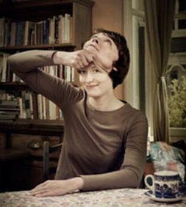
The foundations For Human Conflicts – Shifting Identity
The Mirror Identity Principle. Is this a true principle?
The Referential Reality Principle. Is this a true principle?
Should a PM or a PMP shift his or her own identity or allow other people, events, or circumstances shift his or her identity from a victor to a victim?
Notes:
POLL: What movie is this picture from? (do this poll after the last picture is shown…)
Pirates of the Caribbean
Blue Lagoon
The Deep Blue
The Descendant
Jaws
- When the global logistics manager tried to keep me from talking to him, how did I see myself in his face as a mirror to me. I try to keep the mirror identity principle in mind when I speak with the project team, especially when everyone is under stress because thru the process of co-creation, people are using my face, words, and actions as a mirror to create their experience. I can’t control their predisposition but I can control what input I give them. The team members are looking at me as an input to their experience. I can try to control what input I give them and I can’t control the output because I don’t know their filters and predispositions. To minimize my risk, I can disclose my filters and suggest ideas or provide filters to the team members so they would know how to process my actions. Input -> other’s filters (add your filters) + predisposition = outcome. You can make small increments so inch forward in dangerous waters and check with all parties offline so nothing blows up because you have tested the reactions and sampled everyone’s positions beforehand.
- The point of the mirror identity principle is for us to be mindful at all times that we are creating people’s experiences. Thru our facial expressions and behavior, they are getting a sense of who they are and how they are doing in duality. Each person who interacts with us, conceives an imaginal figure of us within their psyche. Just like a butterfly develops from imaginal cells of the caterpillars, each one of us develop an imaginal figure of how we experienced other people and places. Since we do not know other people’s filters and dispositions, when I am not mindful, which is quite often, I become unaware of how other people might perceive and interpret my behavior. I had oral surgery last week and I went straight from the doctor’s office to pick up my daughter from a school. I was allowed to sit in the office that day and when returned the following day, I saw envelopes stacked on the table so moved the envelopes to the other side of the table. I had forgotten that I was a guest and the people in the office got upset with me and asked me to leave. That was just a reminder that even though it is ok for me if someone else moved the envelopes to make room on a table, it does not mean other people who might be having a stressful day would react positively to that. So not only to be aware of how my identity rises by looking into other people’s faces, I need to remember that other people create their identity thru interacting with me. I definitely don’t want them to feel disrespected, unimportant, and not accepted. I am cautious to not create the imaginal figure of a victim in other people when they interact with me.
This picture of a girl diving comes from which movie? Answer: the descendant, right after George Clooney, who played her father, told her that her mother had died in the hospital after being in a coma from a boating accident. In order to be a descendant, you must have what? Ancestors. So without ancestors, you can’t be a descendant. Everything arises in relationship to something or someone else in the human reality which is dualistic. Everything arises from something else. The application of the referential reality is that it gives us a frame work of how ourselves and other people experience life. People have reference groups. For example, “keeping up with the Jones” is to make sure that we are doing well relative to the Jones. When we get into conflicts, invariably, people are having collisions of how they relate to themselves and other people in their interactions. To fully understand other people’s perspective, we need to get inside their reality and how they are relating to the people and the events. For example, this manager once said to me that “he is a human being and that he is overworked” That told me loud and clear that he feels that he is being asked to do way too much. The referential reality principle cannot be easily used by the people involved in the conflicts because the intensity of their emotions and the Creator’s Complex make them feel righteous. We as mediators can observe and present their perspectives to the group.
Pick your reference points. Don’t pick something that would trip you up or keep you off-balance all the time. We may lost balance and be able to regain balance quickly when the goal is to get the job done or ship the release..
People say that “attitude is the forerunner of conditions” and that “An optimistic attitude is half of success” Victor Frankle, who survived the NAZI concentration camp, in his book “Man’s Search for Meaning” said that “The last human freedom is the ability to choose our response under any circumstances” so it is completely within our power to condition ourselves to be optimistic under difficult circumstances. So keep on smiling deep down inside (-:

Slide 16
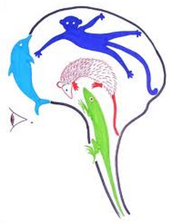
The foundations For Human Conflicts – The Human Animal
The Reptilian Brain – Daniel Goldman “Emotional Intelligence”
Stimulus =>Response – The Amygdale short-circuits thinking.
We need to cultivate (video) Stimulus => CHOICE => Response
The Human Genome – Many animalistic genes are dormant in humans. For example, one in a million, a tail can show up
Notes:
Human beings are designed for hair-trigger responses to fight or flight from the saber-toothed cats. This speed of human response required for our survival is also quite error-prone in how we handle differences and conflicts.
This video shows Mr. Rogers in how he presented to senator Pastori and won the grant for public television. Probably can watch it later.
Needless to say, we need to be extremely aware of these tendencies and not get tangled up in the human tendencies.

Slide 17
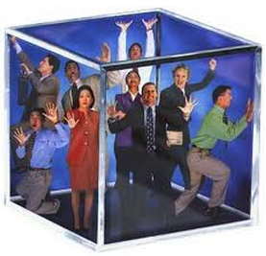
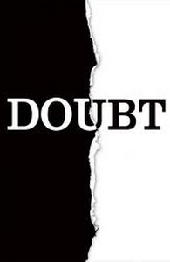
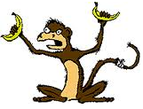
The foundations For Human Conflicts – Human Animal
Human beings are designed to see the world as individuals. We can’t help but being subjective. We cannot be objective and we can only compensate for our subjectivity.
Little turtle on a picnic.
All human conflicts begin internally thru thoughts and beliefs.
All conflicts are rooted in intrapersonal conflict.
Whatever ideas or actions one refuses to accept could become a conflict.
Notes:
Going back to the Monkey mind which throw out thoughts that you don’t think..
It’s like you need to hold on to the team’s Missions, Vision, and Value statement and use that as a personal filter. So when the monkey mind cooks something up and when things begin to go wrong, you could hold on to those guiding thoughts and not get swayed by what othrs are saying and what is going on around us.. This is another step towards self-mastery and self-determination.

Slide 18
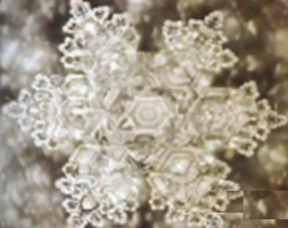
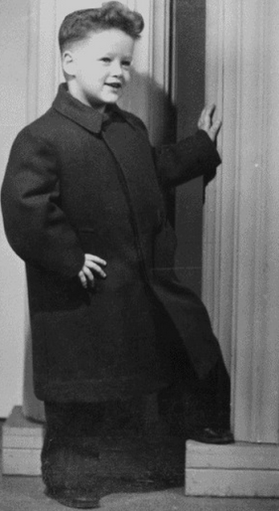
The Prerequisite of Harmony
We can’t just build the third floor:
Interpersonal harmony follows intrapersonal harmony.
Key Prerequisite Life Skills (i.e., existential skills) for Harmony:
Consciously relax and in-self-control.
Emotional balance, emotional stability (e.g., like a vine).
Emotional resilience and perseverance (i.e., abilities to recover/comeback under difficult & hostile circumstances).
Recap: Applying TQM principles to Harmony
Output = Input + Processes
Output =
Input + Emotional Intensity + Mind Realm
+ Personal Filter + Predisposition
We can affect all of the above
Input includes filter, intensity (e.g., balance), Realm
Notes:
POLL: Which president of the US is this boy? (do this poll after the last picture is shown…)
JFK
FDR
Eisenhower
Obama
Clinton
The biography channel showed a program on Bill Clinton and the program was titled “The Comeback Kid”. Let’s go beyond likes and dislikes, Bill Clinton has definitely demonstrated resilience. He was under siege and survived it which required mental strength and control. It is important to be able to continue to cooperate when there is no cooperation.
We can control the input and affect the process realizing that the Mind Realm and Predisposition are semi-permanent or permanent for most people.

Slide 19
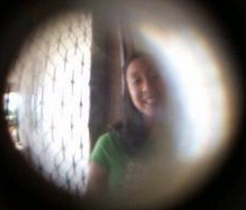

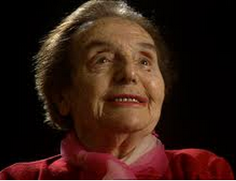
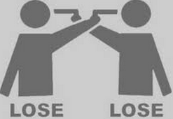

The Prerequisite of Harmony
Key Prerequisite Skills for Harmony:
Define clearly/quickly and defend boundaries assertively (i.e., isolation, repositioning, re-direct).
Peep-hole versus living room brawl
Churchill on the timing of neutralizing hostility
Create positive emotional responses in self and ?others. Unconditional Positive Regard is a principle and a choice.
Hatred poisons the hater, not the hated per Alice Herz’s video
Treat your body & mind to good feelings only (See 3 min. of video)
Apply leverage using correct principles. To approach Win-Win, your actions need to align with the correct principles.
Let the past go, be Sincere and Committed to Harmony, Non-striving (e.g., Ripened Fruit).
Notes:
A metaphor in dealing with conflict at work and on your projects which really same as dealing with conflicts at home: Peephole - It is much easier to keep a thief outside rather than fighting them off in your living room! My Mom was a student in exile and the students retreating with the Nationalist government were often out of food and hungry. In some cities, the local residents would offer them food but in some cities, they had nothing to eat.
Reagan also voiced similar sentiments about how appeasement and accommodations lead to fight or surrender but not peace or war. The point is that some bullies need to be stopped by boundaries or hard limits. You don’t need to guard your borders against everybody but there are some who are focused on dominating others thru aggression and intimidation for territorial, power, and financial gains. It appears to me that human nature almost needs to have boundaries because if we go back to the mirror identity principle that if someone looks at you as if you are not there, then they will walk right over you. It is to establish yourself in the psyche of others in such a way that they would respect your boundaries and limits which is much more conducive to teamwork, collaboration, and profit.
The word “principle” goes to Youtube with Alice for 3:50 seconds
The word “value” is Alice at age 108 on YouTube for 1 minutes 30 seconds.
- the word “Video” is for anyone interested to watch on their own -> Alice’s neighbor talking about enjoying Alice’s music.
Using the correct principles: Understand the ecosystems of workplace conflicts and the dynamics of the different variables such as the gravity and impact of personal, team, project, and organizational lifecycles. Problems are solved differently in an entrepreneurial company versus a mature multinational corporation. In the sea of complexity and changes, how do you achieve Win-Win? Human nature seems to be very prone to lose-lose if we just observe how spouses treat each other. The correct principles begin with managing your own emotional balance, define mental and physical boundaries, acquire the skills to maintain personal harmony first and then interpersonal harmony. Then based on your assessment of the ecosystem, take the appropriate action that would lead to Win-Win by being aware and compensating for my human traits of personal filter, creator’s compelx, tit-for-tat, shifting identity principles, the chattering mind and the principle of predisposition. Once I can manage to not trip myself up over my own human traits, I can see to avoid pushing people’s buttons and pushing them off balance while accomplishing the company’s and project’s goals.
Churchill on timing of dealing with hostility: In Rivers of Africa (1893), Winston Churchill observed:
If you will not fight for right when you can easily win without bloodshed; if you will not fight when your victory is sure and not too costly; you may come to the moment when you will have to fight with all the odds against you with only a precarious chance of survival. There may be a worse case. You may have to fight when there is not hope of victory at all, because it is better to perish than to live as slaves.
The Knife of never letting go: Kindly note that none of this is about being good or being kind. It is about self-preservation and getting your way with minimal cost. It’s about being practical, productive, and profitable.

Slide 20
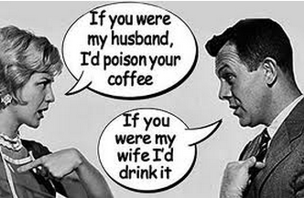

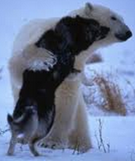
How to De-escalate Conflicts.
Understanding the Anatomy of Conflicts
How do we deal with Differences? Six Levels: Persecute, Reject, Tolerate, Accept, Honor, Celebrate. Fear, expectation, & the need to control.
Personal filter creates conflict – Always takes only one person to create a conflict in one’s mind.
Tit-for-Tat, revenge, retaliate, invalidate, control, and punish. Escalation..
Reconciliatory Principles
Precise Reflection Principle – can lead to acceptance (e.g., the Logistics Manager).
The limit of my personal understanding is described by the principle of the unknown or unknowable.
Notes:
POLL: Which is your predominant emotion while dealing with serious conflicts in yor life? (do this poll before showing the first bullet)
Persecute
Reject
Tolerate
Accept
Honor
In the picture what emotions are being experienced by the lady and the gentleman? Persecution and rejection are the unfortunate and very natural immediate progeny of Creator’s Complex, Tit-for-Tat, and Shifting identity principles.
Does anyone know how to say National in German? Well, it is Nazional, spelled with a “Z” instead of a “T”. So the word “NAZI” really is describing something very neutral.
Picture of the dog and the bear: lunch is tastier when there are no open wounds and everyone gets to advance rather than getting side-tracked over disagreements.
Any thought that you repeatedly think becomes a belief so after you have validated that the two Reconciliatory principles are true principles then you could use the Chattering Mind principle to think about these principles 12,000 to 60,000 times a day. That way, these principles becomes ingrained in your subconscious mind and then you are changing your predisposition so in the future you would immediately know that this is happening for some very precise causes-and-conditions and just like the pre-disposition, it is impersonal. And to tame the Creator’s Complex in each one of us, we own up to the fact that our personal filters are very limited and that we don’t know everything and however ludicrous something seems to us, we know that whatever we perceive that we are experiencing is a precise reflection of all the events that have gone before. And some of the causes and conditions are unknown and unknowable just like you do not know the name of the person who manufactured your computer screen and it might be unknowable where that person got the lead to actually find the job that allowed them to help produce your computer screen.

Slide 21
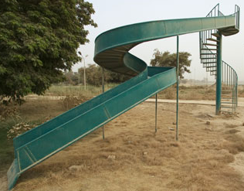
How to De-escalate Conflicts.
Understanding the Anatomy of Conflicts (note, See Healing Anger)
The giant slides of anger are constructed and lubricated by?
Righteousness from the Personal Filter.
Indignation from Creator’s Complex.
Escalation based on Tit-for-Tat.
Solution:align actions with principles
Notes:
So now we will see more applications of aligning our actions with the correct principles at the right time.

Slide 22
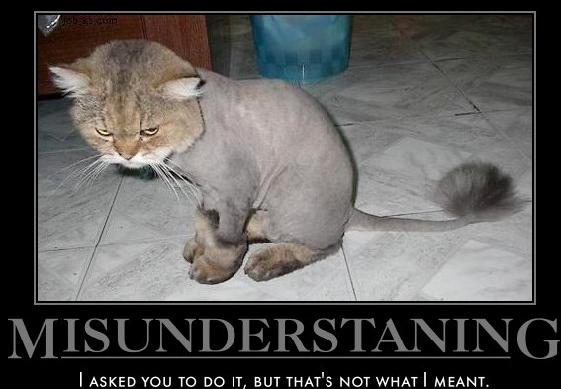
How to De-escalate Conflicts.
The Anger Development Life Cycle, exit points & lead-er-ship:
Experience an idea or an action.
Apply personal filter.
Resisting the idea/action mentally (Creator’s Complex, Chattering Storyteller Mind).
Taking antagonistic action (Tit-for-tat).
Add anger and intensity resulting in upset stomach, muscle tension, sleeplessness, aches, and pains (i.e., the Chattering Mind).
Open warfare or cold war straining the relationship. Can result in personal chronic pain, muscle spasm, and muscular pain.
Notes:
Beginning - It is my personal experience that most of the conflicts are caused by misunderstanding. Gandhi said that there is more to life than adding speed and aggressions so when we live the giant squids who also live fast and furious lives, we create lots of broken threads in our conversations and there is little time for balanced, neutral, and open exchanges. There are too many daggers coming out from our eyes and fire spewing from our mouths and nostrils because we are mad mad mad and don’t nobody stand in our way!!!
End It is natural and normal but very unfortunate when we need other people to behave a certain way for us to feel safe, important, accepted, competent, and necessary. When people do not act according to what we expect, we begin to read the tea leafs and gaze into the crystal ball with the storyteller mind which can spin up lots of very believable stories while none of which may be true. I would feel insecure when I am not provided certain documents or invited to certain meetings as a contractor but often times people have different work habits which are not necessarily same as my predisposiiton, expectation. What if I navigated according to principles which are a lot more reliable than my feelings ot other people’s behavior as a guide for the direction of my life. The direction of my life is calibrated moment-by-moment by my thoughts and acitons and the summation is my life. Sow a thought and you reap an action; sow an act and you reap a habit; sow a habit and you reap a character; sow a character and you reap a destiny.

Slide 23
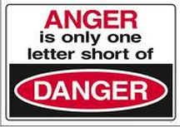

How to De-escalate Conflicts.
The Anger Project - The purpose of the project is to develop the skills to abort the project ASAP
Project Charter – I am right (i.e., Creator's Complex).
Stakeholder – I, me, and myself.
Project Initiation – Perception (i.e., Personal filter) Resistance, Resentment, Rejection, Repression.
Scope – Do whatever it takes to Win (i.e., Tit-for-tat/ One-Upmanship).
Time – Now and Forever.
Risk – Ruined health and relationships.
Vender – Gossip and Fraction.
Budget – At All Cost.
Notes:
Scope – All is fair in love and war.. My vote is that love is fair in all war. The point is not about being good but about self-preservation. Do I feel physically better and find it more enjoyable when I experience anger or when I experience joy? At least I reduce my own suffering.
Risk – Not to mention failed projects and potential job loss…
Let’s create our DMZ starting with our own mind, mouth, at home, at work, on the projects to when I am able to remain in the DMZ while provoked or being attacked. It is easy to be peaceful in a non-violent situation. Navigational skills really count in storms.

Slide 24
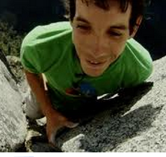



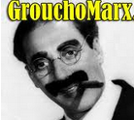
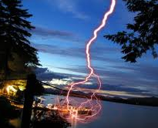
Cultivate De-escalating Muscles
The Operative Practices to enable Harmony
Relax, don’t resist. Experience your human emotions w/o acting out. Apply principles.
Allow space and be spacious.
Don’t take a fixed position . Remain neutral. Align with principles, not others.
Apply the Precise Reflection Principle.
Applying the Principle of the Unknown and the Unknowable. My Jurisdiction.
Applying the Harmony versus Coercion Principles.
Harmony – to use forces inside or outside of you.
Coercion – to go against forces inside or outside of you.
Notes:
POLL: Why do lightening happen? (do this poll after the lightening picture is shown…)
Too much moisture
Too much electricity
The ions lost by the ground make the earth positively charged and the sky negatively charged
The earth has a conductor attracting the lightening
Someone wants to barbeque or be barbequed (-:
Beginning - Principles include the precise reflection principle and the principle of the unknown and be able not to lash out when prompted by the Creator’s Complex.
After Groucho Marx's picture: These are my principles and if you don’t like them, I have others.
After the picture of the fire burning – fire bruns paper, water puts out fire, water in pot can be evaporated by fire and hot enough fire, pot will melt..so give fire space and the fire will burn itself out…
After My Jurisdiction: Ask, is how he speaks or acts within my jurisdiction? Besides illegal hostility or discrimination, do I have jurisdiction over how people should behave or how competent they should be? Even if it is my jurisdiction like caring for my 12 year old girls, I must remember that the use of different types of power have different consequences. The use of official or coercive power backfires because there will be unexpressed feeling and since unexpressed feelings don’t die, they come back in ugly ways. By using dominance to shut the other person down is like throwing out the baby with the bath water because when you suppress dissension you also suppress their flow of ideas. When you repress your anger and you also repress your joy. Khalil Gibran said that if you don’t cry all your tears, you won’t laugh all your laughter. So one of the worst things to use is the coercive power. Give people psychological air and the freedom to disagree where you can agree to disagree agreeably. Efficiency is what we use with updating an excel spreadsheet but effectiveness is what we use with people to make sure that we not only have their commitment and passion in the project but also to earn their trust as well as increase our rapport. Use expert, referential, social powers instead. It’s very poignant when we can use principles and present filters which are aligned with common sense. It is very powerful to show how something is right or wrong by sharing an expert’s point of view. Right makes Might. A speech Abraham Lincoln gave in Cooper Union.
All of these principles are meant to de-escalate and move you up the Mind Realm from anger to reason, acceptance, and neutrality where you are more powerful and more in control.
Part of being relaxed is being balanced or with minimal emotional intensity where you have discharged your anger or judgments. Since unexpressed feelings don’t die and come back in uglier ways, have you expressed and released the pent-up emotions? How many people know why lightening happen?
It’s hard to relax when you are all pent-up and release thru chemical substances have side effects so find activities such as chatting with friends, bike-riding, or sports to bring yourself to neutral or as close to neutral as possible because being neutral is a very powerful position.
After the Gymnastics picture: My daughter did gymnastics for 5 years and when I watch these girls do back-flips on the beam, it looks like magic and quite incredible. But in reality, these girls spend many hours a week and make very small incremental progress just like in cultivating the conflict de-escalating muscles. It takes focus, dedication,a nd lots of practice over time to shift from having a coercive orientation to having a harmonious disposition.

Slide 25
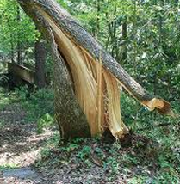
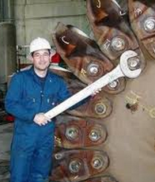
The Creative Principle of Harmony
The key to de-escalation of conflicts is to respect your opponent’s position. Use Power, not Force.
Even if it’s an aggressive and demeaning one. To not aggravate the situation, you must leave your opponent’s position unaffected and without reacting or identifying with it. Just observe any recoiling and revolting emotions you might have.
This is the Isolation principle which is equivalent to acceptance or respect for your adversary’s position.
You will make your move from your opponent’s perspective without discounting it in the slightest (i.e., no provocation).
Notes:
“Power” is link to the map of consciousness which we have seen previously. NO need to mention it.
Now we are into the tactics of executing with harmony in mind. For example, see how the wrench that grabs the bolt does not move from it. Once engaged, the region of of conflict is undisturbed and not moved. To leave your opponent’s position along is key to your ability to maneuver around it. Because if you attacked it, your actions are controlled by it and you have gone where the opponent asked you to go. Instead, reserve your energy and only go to places which are most beneficial to you. Also, given Newton’s law of action and reaction. For every action you take, you will create an action that produces an equal and opposite reaction. Then, you are caught in a chain of reactions initiated by your adversary and instead of running you own agenda, you are now in someone else realm of anger or courage and you are spending your precious time playing their game and not focused on accomplishing what you would like to accomplish...
Last bullet - Acknowledge their position without moving it or resisting it in the slightest so you don’t draw more energy into their position. If you resist, they will send in reinforcement by adding intensity and focus on their position. The Newton’s Law of Action and Reaction is immutable. http://en.wikipedia.org/wiki/Newton's_laws_of_motion

Slide 26
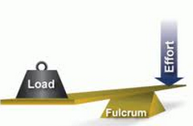
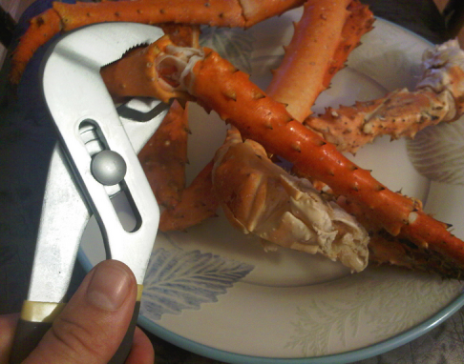

The Operative Practices to enable Harmony
When you make your move, you are using the Re-positioning principle by building on top of your opponent’s position with full acknowledgement and appreciation of your opponent’s position.
The last principle of assertive communication is to express positively and gently. Land & invoke positive emotions.
Exercise: re-arrange these words in the spirit of this session: “All is fair in love and war”.
Notes:
After first bullet – When I said to the Logistics Manager that “I object that you can’t even talk to me” – I was escalating the conflict and not de-escalating because if I turned around and walked out of his office, then I could no longer hold him accountable for making that shipment.
After second bullet = remember Output = Input + processes? If you manage the output only, then you become a spectator and are dealing with the after effect of the production. This is where you assert your INPUT
After picture of crunching the crab leg: just crack it enough to get what you want. No need to shatter it and smash the crab meat in the process.
Someone please type an accusation in one sentence and we will use that to demonstrate “Assertiveness” which is neither passiveness nor aggressiveness nor passive-aggressiveness.
After last bullet: kindly take 20 seconds to type in how you would re-arrange these words: “and love is fair in all war”.

Slide 27
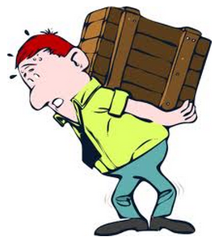
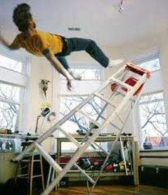
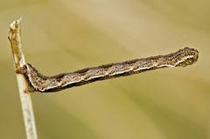
The Operative Practices to enable Harmony – Bad Example
For example, Jose says to me that “it is bad for you to carry that case by yourself”.
I can answer Jose “It is not heavy.” and negate his position which could trigger his fight/flight/freeze responses. Many people rely on others to behave positively in order to maintain balance and composure.
Jose could then get bent out-of-shape and begin to escalate and go for tit-for-tat by pointing out everything that Jerry does is wrong.
Notes:
After picture of the caterpillar: According to the mirror identity principle, we derive our standing or position or ranking in duality by referencing something or somebody. Just like the caterpillar who needs to grab onto the branch in order to reach out. Most people get their identities most of the time from how others are treating them. Especially when the Mind Realm is already in anger, shame, guilt; the responses are from the same Mind realm. People say what do you get when you squeeze an orange? You get orange juice. Why? Because that is what is inside so when we bump into people or when people rub us the wrong way, what comes out is our predominate emotion created by the Mind Realm which we are in. As we said previously, for most people, these mind realms transcend moods and people are caught in them.

Slide 28
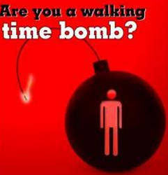
The Operative Practices to enable Harmony – Good Example
Assertive communication “Jose, thank you so very much for being on the lookout that I don’t accidentally hurt my back. Is that what your concern is?” (i.e., Isolation)
“Jose, I have been going to the gym during my job transition for about 15 hours a week so I am in pretty good shape and I promise you that I won’t hurt my back. (i.e., Reposition)
I really want you to know that I appreciate you looking out for my personal welfare!”. (i.e., Assertive communication of Reassurance and Appreciation)
Notes:
After picture of time-bomb: by using the isolation principle, we are less likely to trigger explosions but remember that:
Output = Input + Emotional Intensity + Mind Realm + Personal Filter + Predisposition
People’s response = My actions + their emotion level + their personality + their conditioned response
Some people are already always angry which not only describe their likely response but also the Mind Realm they are normally in when they are silent and keeping to themselves.

Slide 29


The Operative Practices to enable Harmony – Physical Example
Relax and Connect (i.e., Isolation)
Align the Body (i.e., Reposition)
Point Ahead (i.e., Express positively & gently or “Assertive Communication”)
Look at examples of top-tier predators in nature.
Notes:
After the picture of the jet – it is very powerful when you apply right makes right when you have manipulated the situation to your advantage. For example, when you make your adversary stretch out their hand while contracting your hand, you end up in a situation where your hand is near you where you are more strength and the other person is fully extended and therefore weaker. For example, when I told the logistics manager that I left him 2 phone messages and sent 3 emails which were unanswered in the past 4 days, I am stretching him out and weakening his position and then when I said, I will leave right now if you would tell me that you are no longer responsible for the shipment and I will go look for someone else. I just fortified my position and weakened his where he had little “good answers”
A response that is less confrontational would be “I am sorry, I am confused. My phone calls and emails to you went unanswered over the past 4 days. Is it because you would rather me engaging the logistics manager in my division?” “I understand that you and your boss think that it is unfair that the Global Logistics team is carrying all the weight and doing the run-around for this very important and complex shipment”. Right makes might and gentleness allows you to build rapport.

Slide 30


Summary
Great Teamwork is possible.
You can unilaterally refrain from adding intensity to a conflicted situation.
Continued assertive communication eventually renders aggressive and passive communication powerless.
PMs add value via soft skills such as team building and synergy building.
Good luck and Practice Diligently! Bloom!
My email is Jerry.KS.Wang@Gmail.com, 310-902-3389 – cell.
Free custom training by request. Click to see rough videos on Vimeo and SkyDrive.
Notes:
After picture of your cup overflowing:
After picture of the bird on the branch
: Talk about the source versus a sink of carbohydrates on a tree. A person becomes a source of harmony after they can overcome their six human traits and be able to compensate for those that are more severely trapped in their six human traits… With your practice and application of the principles, you are a source of harmony or your projects and can help any organization to increase their velocity in obtaining results.
At the end of the slide – ask for if there are any questions.

